Slide 1
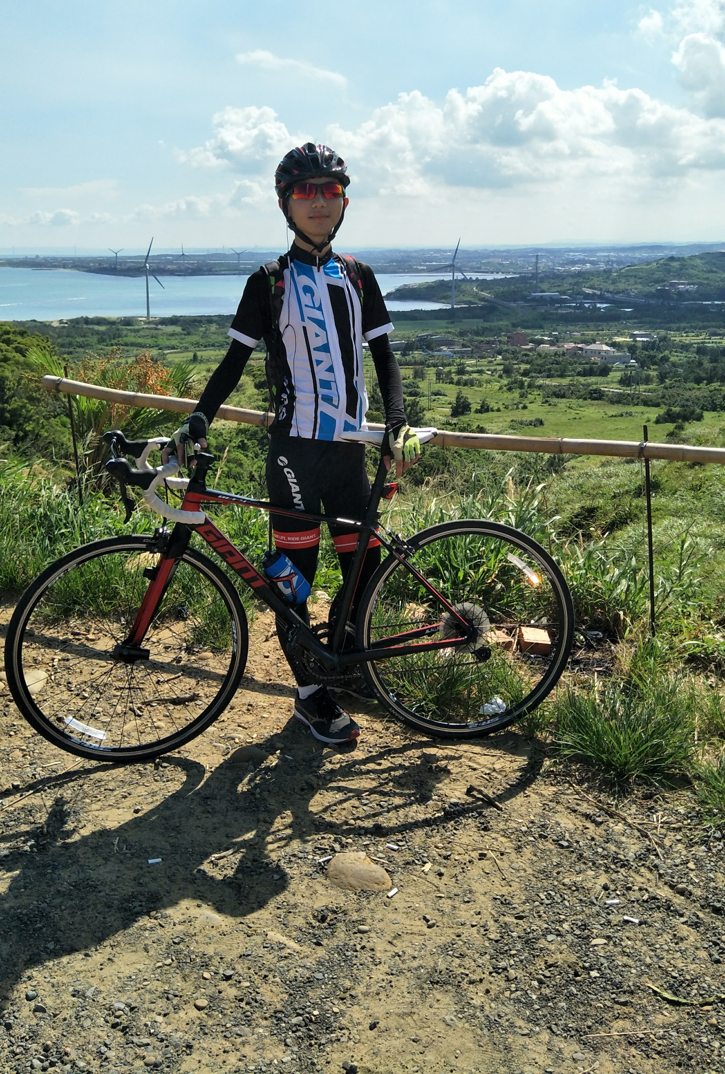
Group : 7
Name : 許家愷
ID : B073040049
Department : Computer Science and Engineering
Birthday : 1999/11/29
From : Taipei , Taiwan
Interests : Cycling , Soccer , Photography
Expectation of the class : To learn skill as a manger
Life Value : Work hard as you can , in the end you can achieve it.
Note: Well , I don’t talk much so please bear with me, thank you!!

